Slide 1


UWA DATA ANALYSIS BOOTCAMP - PROJECT 2 ETL TEAM 6 proposal
Our Team
Johan Snyman
Jon Wood
Our Git Repository
https://github.com/jonowood/Project_2

Slide 2
Project 2-Etl : ERP vs. AWE Our team will select, analyze, extract, transform and load a dataset to allow data analysts to analyze the following: How does average weekly earnings influence Estimated residence Population
Data Sources
Review
Inspect
Simulate
E
T
L
Activities
Extract
Transform
Load
Locate and download data
ABS – AWE.CSV 27K datapoints
ABS – ERP.CSV 7,5K datapoints
Prework, structure, common keys, duplicates and NAN
Data formats
Design ERD flow for desired table elements
Create POSTGRES Tables
Load .CSV to Python and convert
Check CSV loaded correctly
Wrangling steps
Cleaning – NAN
Align Time/reasons
Rename headers
Remove columns
Join
Connect to PostGres
Load Data
Check and test data

Slide 3
transform
extract
Data Sets
Datasets Sourced From - https://explore.data.abs.gov.au/
File A - ABS – AWE.CSV (27K datapoints) - Population Movement Data for Australia
File B - ABS – ERP.CSV 7,5K (datapoints) – Average Income Data for Australia
REQUIRED STEPS TO TRANSFORM DATA;
File A - ABS – AWE.CSV (27K datapoints)
Filter column C values to only include ‘Earnings’
Filter column B to only include 'All employees average weekly earnings’
Filter column G to only include ‘Original’
Copy columns to DataFrame - REGION: Region, TIME_PERIOD: Time Period, OBS_VALUE
File B - ABS – ERP.CSV 7,5K (datapoints)
Filter column B to only include ‘4: Internal Arrivals’, ‘5: Internal Departures’, ‘6: Net Internal Migration’, ‘13: Change Over Previous Quarter’
Copy columns to DataFrame - REGION: Region, TIME_PERIOD: Time Period, OBS_VALUE
Pandas Transformations

Slide 4
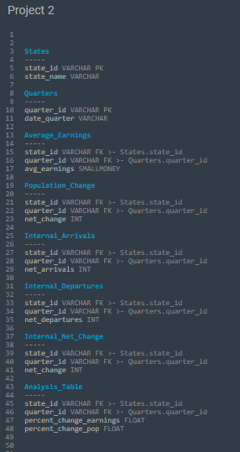
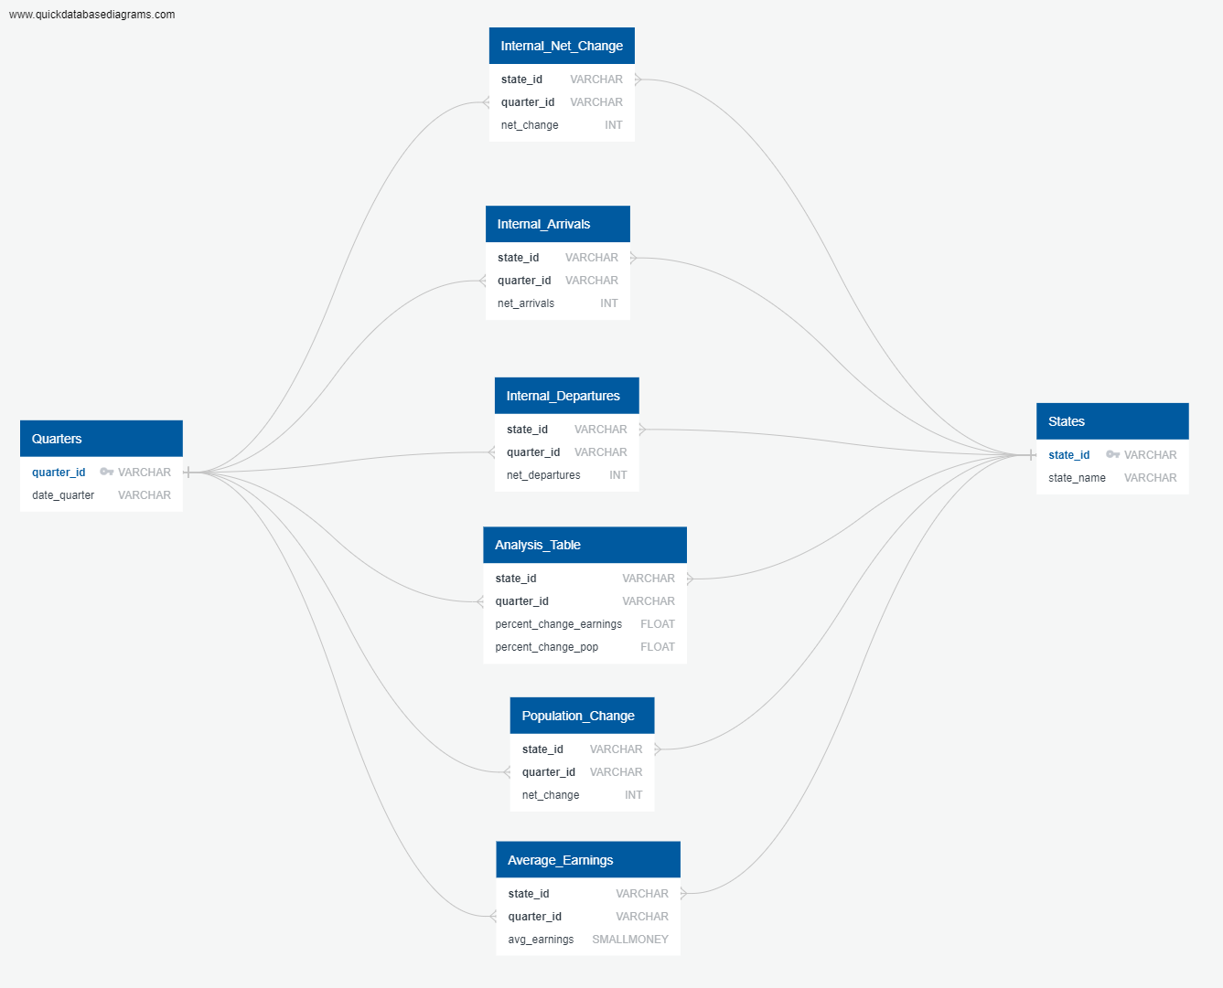

load
We will create a Database and Schema in PostgreSQL then Load the data for future Analysis

